Slide 1
Leapfrog Method for solving the time-dependent Schrodinger's equation in 2 dimensions
Spenser Burrows with assistance from Dr. Nicholas Giordano

Slide 2
Leapfrog Method for TDSE
The time-dependent Schrödinger's equation can be written as:
Ψ is and imaginary quantity, so the TDSE can be split up into real and imaginary components (neglecting units):

Slide 3
The real and imaginary part can be approximated using centered differences as:
This can be rearranged into the following useful forms:

Slide 4
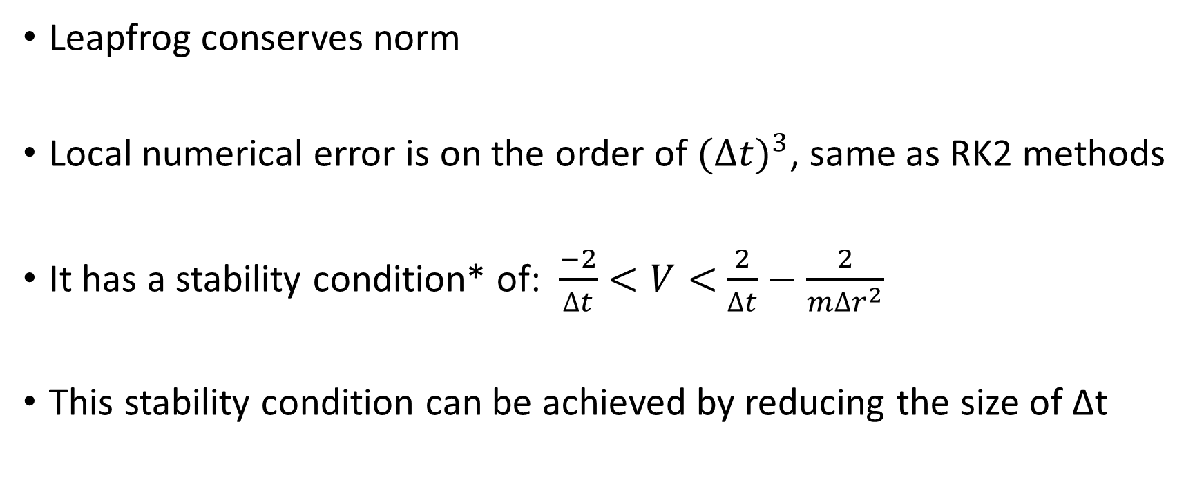
Advantages of leapfrog
Leapfrog conserves norm
Local numerical error is on the order of ${(Δt)}^{3}$, same as RK2 methods
It has a stability condition* of: $\frac{−2}{∆t}<V<$ $\frac{2}{∆t}−\frac{2}{m∆r^{2}}$
This stability condition can be achieved by reducing the size of Δt
*A fast explicit algorithm for the time‐dependent Schrödinger equation
Computers in Physics 5, 596 (1991); https://doi.org/10.1063/1.168415
P. B. Visscher

Slide 5
Leapfrog Method for 2-d TDSE
In 2d systems, the spatial derivative becomes more complicated and can be approximated as shown below:

Slide 6
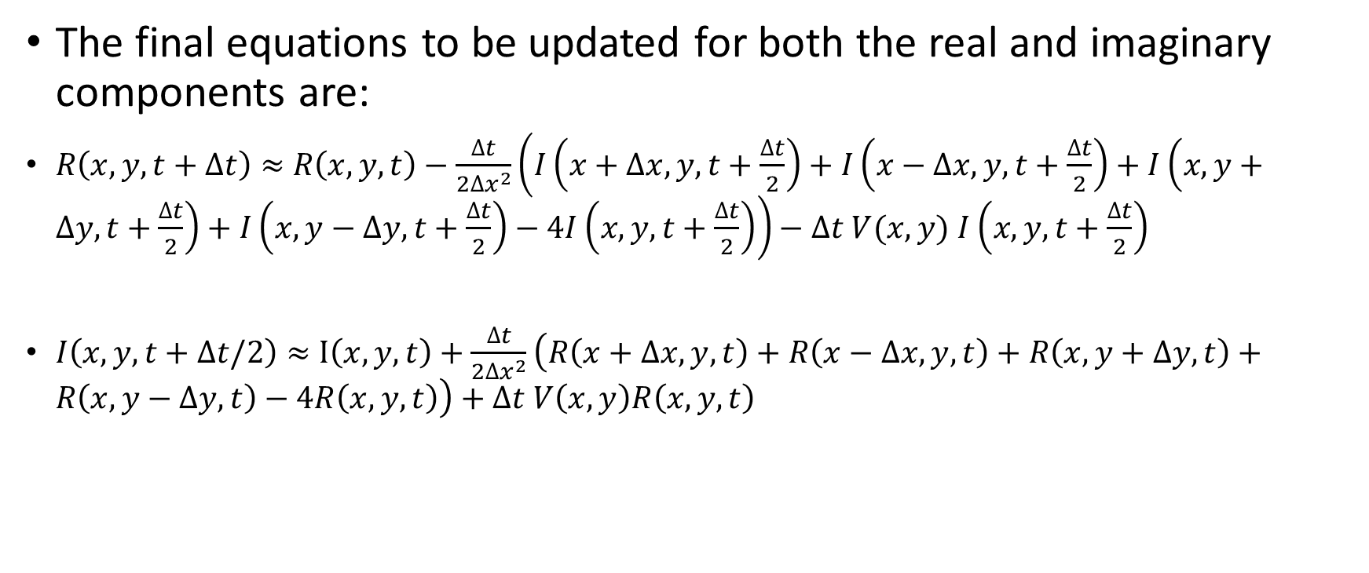
Leapfrog Method for 2-d TDSE
The final equations to be updated for both the real and imaginary components are:
$R\left(x,y,t+∆t\right)≈$ $R\left(x,y,t\right)−\frac{∆t}{2{∆x}^{2}}\left(I\left(x+∆x,y,t+\frac{∆t}{2}\right)+I\left(x−∆x,y,t+\frac{∆t}{2}\right)+I\left(x,y+∆y,t+\frac{∆t}{2}\right)+I\left(x,y−∆y,t+\frac{∆t}{2}\right)−4I\left(x,y,t+\frac{∆t}{2}\right)\right)−∆t V(x,y)$ $I\left(x,y,t+\frac{∆t}{2}\right)$
$I\left(x,y,t+∆t/2\right)≈$ $I\left(x,y,t\right)+\frac{∆t}{2{∆x}^{2}}\left(R\left(x+∆x,y,t\right)+R\left(x−∆x,y,t\right)+R\left(x,y+∆y,t\right)+R\left(x,y−∆y,t\right)−4R\left(x,y,t\right)\right)+∆t V\left(x,y\right)R\left(x,y,t\right)$

Slide 7
Double slit problem
For my project, I was assigned a 2-d leapfrog through at double slit potential as shown below:
My Fortran code propagates a
2-d wave-packet through the
Potential barrier

Slide 8
Time-step sensitivity
My Fortran code is very similar to one written in MATLAB that propagates a 2-d wave-packet in a region with a solid wall
This MATLAB code uses a timestep of Δt=.00001 and returns the expected results

Slide 9
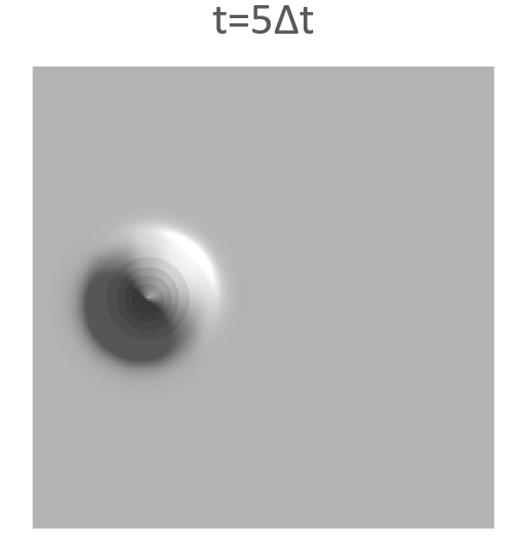
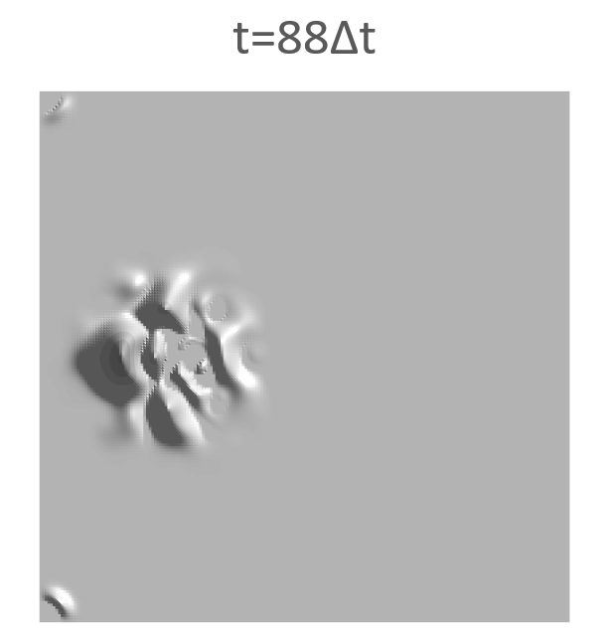
Time-step sensitivity
Using the same timestep of Δt=.00001 in my Fortran code results in an unstable calculation, even with no potential barrier
The timestep I used was Δt=0.0000005, 1/20th the size of the one that the MATLAB code was able to use

Slide 10
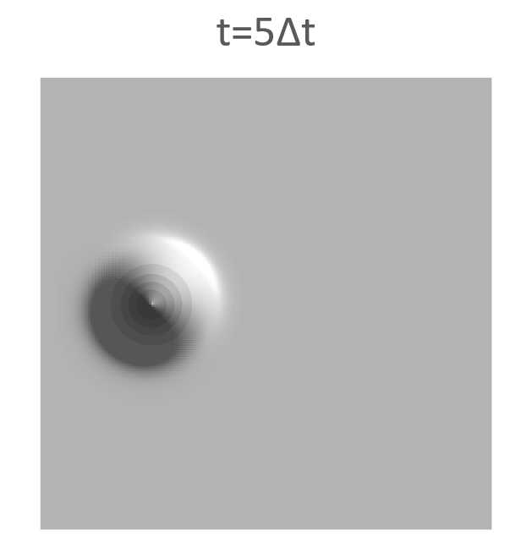
Results

Slide 11
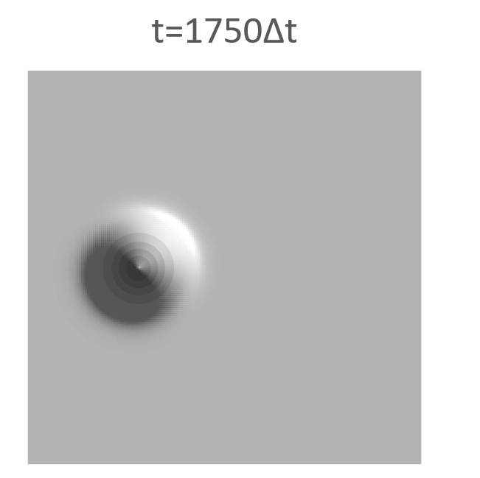
Results

Slide 12
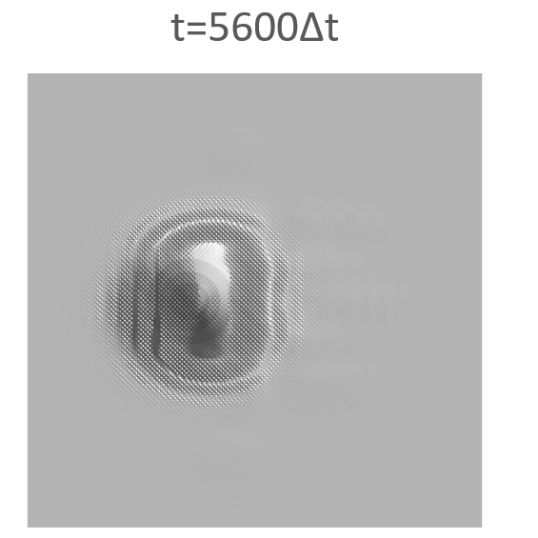
Results

Slide 13
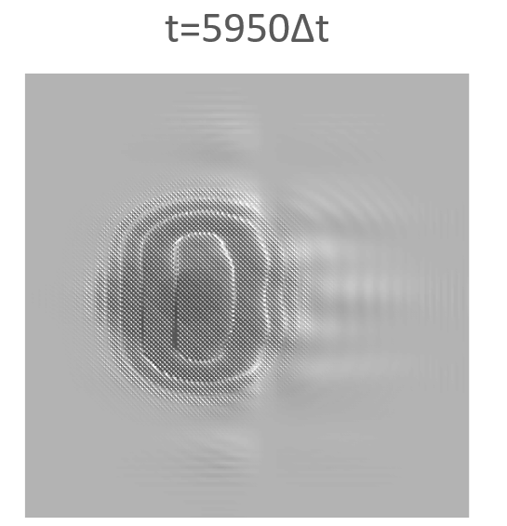
Results

Slide 14
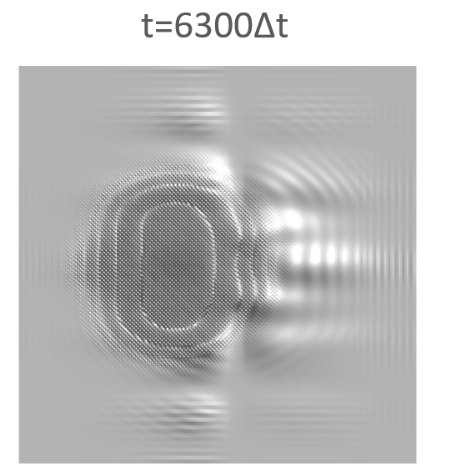
Results

Slide 15
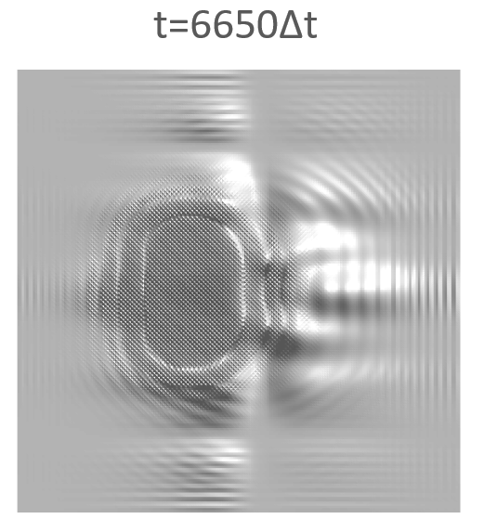
Results

Slide 16
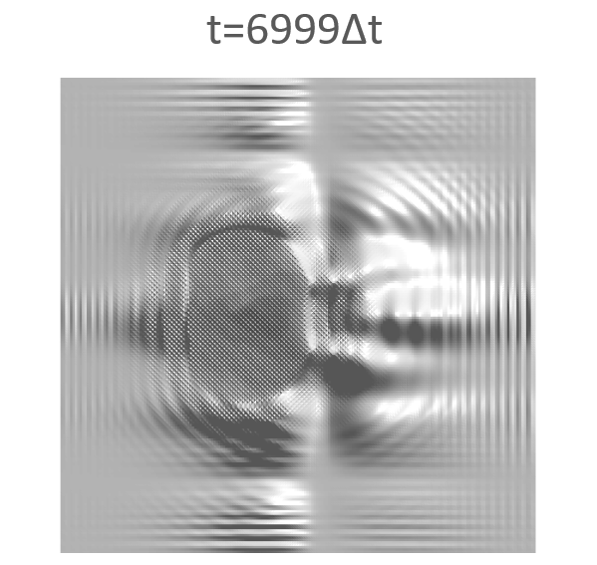
Results

Slide 17
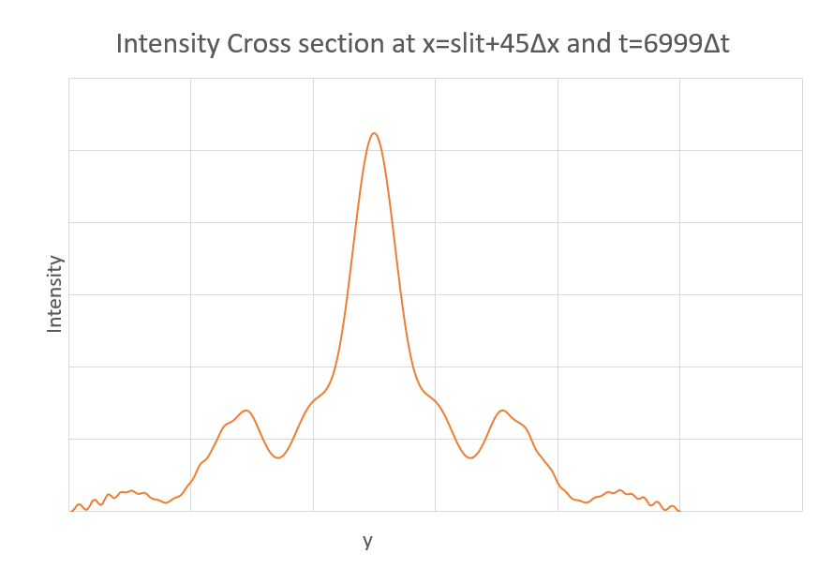
Results

Slide 18
Possible improvements
Future improvements to this code could include:
An option for a diffraction grating potential instead of a double slit
A sorting loop to find the angular position of the diffraction peaks
User interaction to define the slit spacing and width
Animations!

Slide 19
Questions?

